Slide 1


GBSE Sensor Sensitivity Study and Automation
10/28/2015
Aman Agrawala
210-459-1737
Form Revised 5/30/12
2012 Copyright General Motors - GM Information
1
Notes:
Instead of putting all directions on the slides, they will be in the speaker notes. The notes will add more detail to the comments that are on the slide.
This is your project file, add more slides and information, or delete the slides that don’t fit your work.

Slide 2
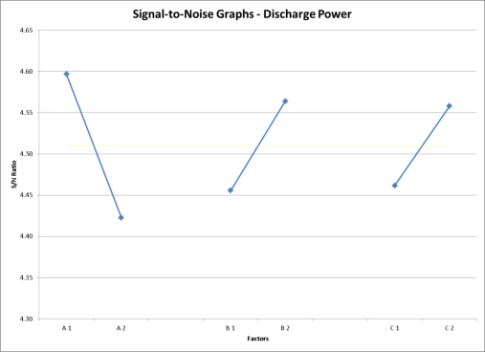
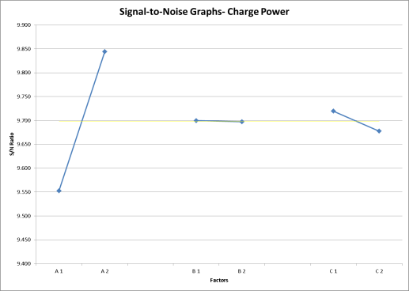
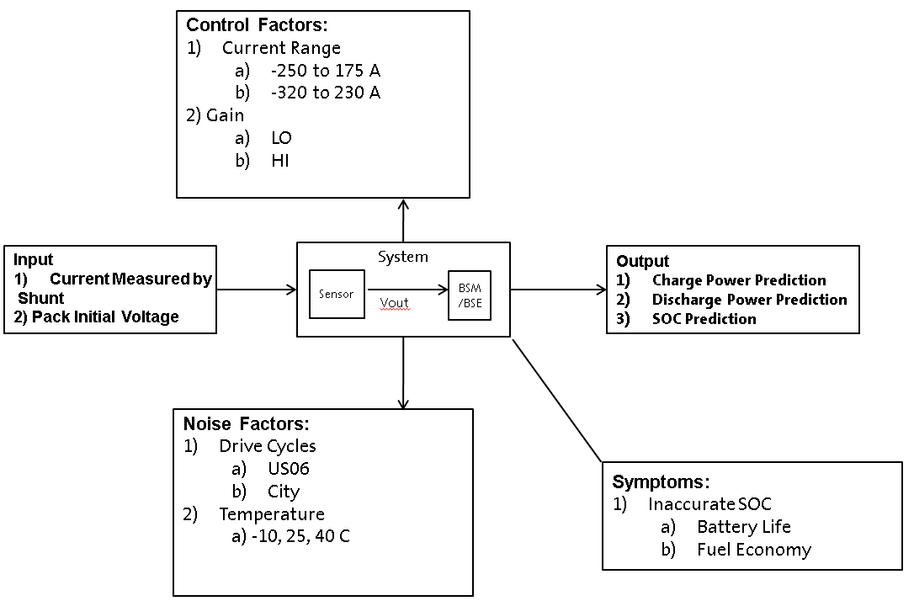
Title: Single Core Current Sensor: Voltage A/D Optimization
Project Leader: Andrew Meintz
Project Sponsor: Paul Kelley
Project: # XXX
DFSS Coach: Dave Osterman
Project Scope
Findings / Learnings
Proposal to change current sensor range calibration
Potential improvement to Power and SOC prediction
resulting in improved vehicle FE and Performance
Calibration changes to reduce range are not beneficial due to
contradiction in response from charge to discharge power
Part-to-part variation is important and was demonstrated
to affect power and SOC prediction error.
P-diagram
Implementation
No changes to the calibration are proposed as a result of this study.
Possible changes to the current sensor hall-effect IC will be investigated by Hannah Bence and Andrew Meintz and will be reviewed in the BAS3 and HEV4 PDTs.
Benefits
Identification of a method to analyze current sensor accuracy has been developed and can be re-used for future programs.
Quantitative analysis has demonstrated that the current sensor range is appropriate for this vehicle application.
Notes:
After you completed the summary slide, please move it to Slide 2.

Slide 3
Team Roster
I
D
D
O
V
Position | Name(s) | Responsibilities
Team Leader DFSS project credit | Aman Agrawala | Develop project plan Execute project – deliver on time and to plan Schedule and lead team meetings Generate and maintain standard project documentation Communicate project progress / status to Sponsor and DFSS Coach
DE / DRE / Subject Matter Expert | Helen Wang Hannah | Provide design data Assignments in area of expertise
Critical Project Contributor DFSS project credit | Patricia Laskowsky Patrick Frost Ashley McAllister Rob Justin Bunnell | System models, create and exercise math model(s) / transfer function(s) Generate experimental data to create / validate transfer function(s)
DFSS Coach DFSS project credit | Garrett Seeman | Coach the Team Leader, train the team, assist in team startup, attend team meetings, participate in all DFSS technical reviews
Engineering Center Sponsor (Director)GFL DFSS project credit | Vincent Rawls | GM management that will review the finished work. Owner of the resources to get the project done.
Notes:
These are the engineers that will help with the project. Not all boxes have to be filled, and not all people have to be at each meeting. Team members can do multiple positions. If you do not need the position, just put in N/A (not applicable).
Proof of certain team member participation on a project is required for DFSS Green Belt certification. Only these 4 positions (Team Leader, Critical Project Contributor, Coach, Sponsor) can use the work for certifications. See the DFSS webpage: http://gmna1.gm.com/vp/sedfss/ under DFSS Certification Requirements.

Slide 4
Project Charter
I
D
D
O
V
Vehicle Program(s)* | H5
Model Year(s)* | 2019+
Vehicle Line(s)* | Future Vehicles
SMT or Integration Area* | Electrification
QRD Focus Area* | 7N
BOM Row #* | 846
Start Date (proposed or actual) | Sept 2015
Targeted End Date | Dec 2015
Required End Date | January 2016
Champion (Exec. Director) | Larry Nitz
Program Sponsor | Tim Grewe, Stephen Poulos
Engineering Center Sponsor (Director) | Bill Wallace
This information* is required to post completed DFSS projects in GDM.
Notes:
Project Charter is required to post in GDM.

Slide 5
I
D
D
O
V
Opportunity Statement / Expected Outcome
Opportunity Statement: Automatically determining sensor impact on BSE accuracy enables GM to make early cost-benefit decision and reduce overspecification or underspecification. Adding this to the process of creating a new pack drives accurate decision making early in the program.
What’s in it for the customer, what is in it for GM? Knowing how good our sensors have to be allows us to efficiently utilize our resources effectively. This speeds up the process of determining what factors have the largest impact on sensors and helps GM make better decisions on what constitutes a “good” sensor. This will enable the costumer to get more reliable power prediction and fuel economy.
Expected Outcome (Specific Deliverables to the program): Impact on BSE accuracy for each set of sensor specifications.
Constraints: Limited to current program packs and drive profiles while trying to predict future pack performance.
Notes:
Opportunity statement:
A plain language description of the basis for the project and the intent or goal of the team. Don’t feel restricted to one or two sentences.
“This is what precipitated the need for the project, here is what we would like to accomplish”
What’s in it for the customer/GM:
A quick statement of what the final buyer will get and what GM will get for our business.
Expected outcome:
A plain language description of what is desired out of the project:
A new VTS / SSTS Requirement
A design best practice
An assessment of the design robustness
A design configuration that meets program / business requirements
Constraints:
A brief listing of any constraints that have or will influence the scope, timing, impact, etc. of the project.

Slide 6

I
D
D
O
V
Scope / System Boundaries
Story: Which sensor is contributing the most, our another way
For our given BSE outputs, which sensor contribute most to its sensitivity.
Sensor Package
Current Sensor
Temp
Sensor
A/D
BSE Algo
Relevant Signals (SOC, Power)
BSE Algo
Voltage Sensor
Form Revised 5/30/12
2012 Copyright General Motors - GM Information

Slide 7
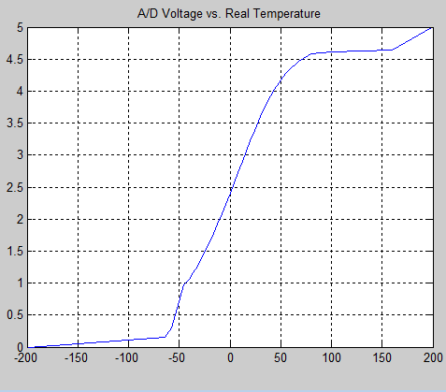
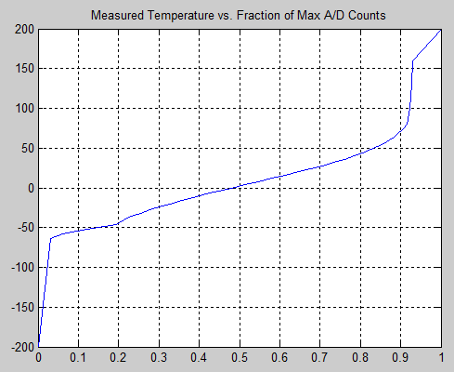
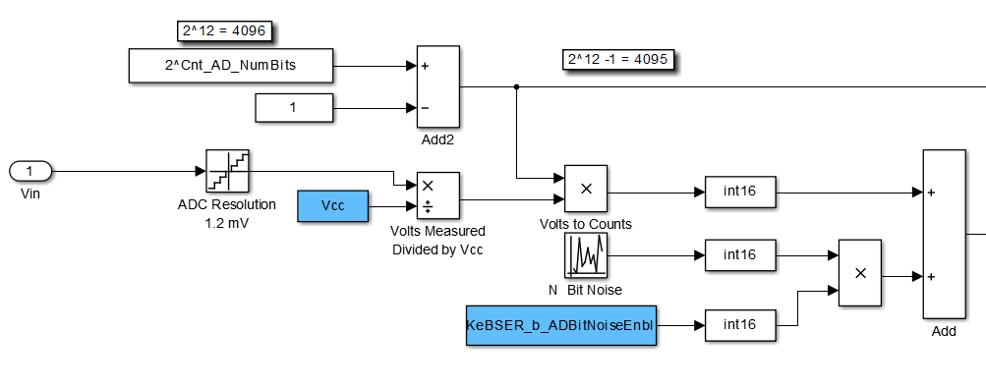
I
D
D
O
V
Temperature Sensor Model
Battery Temperature
to Thermistor Voltage
VITR Controls
Scaled Integer UW_15
to Float
(VeVITR_T_HV_BatTemp)
Battery
Cycler
Temperature
°C
Volts
+
Sample
and
Hold
A/D Converter
Counts
(0 – 4095)
VITR HWIO
Counts/4095
Scaled Integer
UW_15
(VaHWIO_Pct_TemperatureSnsr)
to BSER
Thermistor Voltage Error
(-Max, Zero, + Max)
Quantization
Thermal Noise
Form Revised 5/30/12
2012 Copyright General Motors - GM Information
2

Slide 8
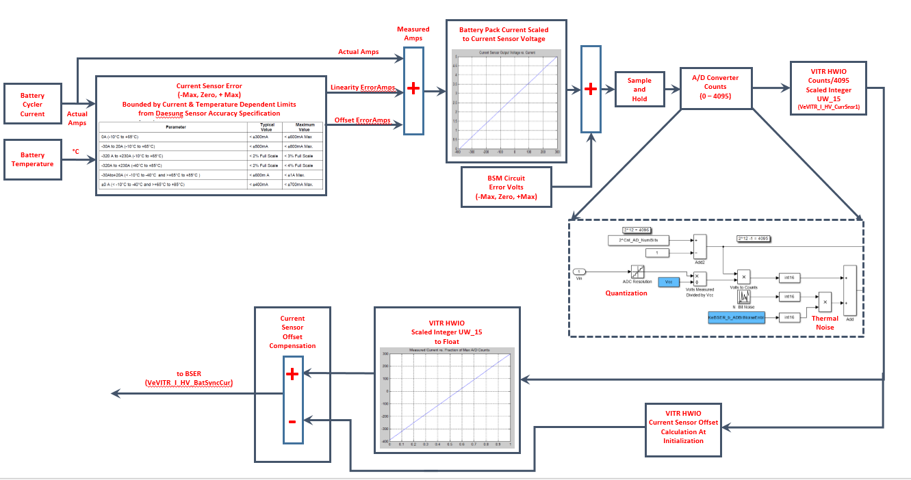
I
D
D
O
V
Current Sensor Model
Form Revised 5/30/12
2012 Copyright General Motors - GM Information
3

Slide 9
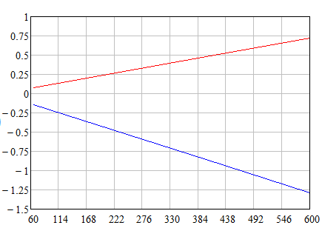
I
D
D
O
V
Temperature Sensor Model
Measured
Volts
Battery
Cycler
Pack
Voltage
Actual
Volts
VITR HWIO
Counts/4095
Scaled Integer
UW_15
(VeVITR_U_BatSidePackVoltSync)
VITR HWIO
Convert to Float
Multiply by
KeVITR_Cf_PackVoltMultiplier
(VeVITR_U_HV_BatVolt)
To
BSER
+
Resistor Divider Model
Scales Pack Voltage to 0-5Volts
Sample
and
Hold
A/D Converter
Counts
(0 – 4095)
Voltage Sensing Error
(-Max, Zero, + Max)
Bounded by VoltageDependent Limits
from BSM HV Specification
Linearity Error Volts
Quantization
Thermal Noise
Form Revised 5/30/12
2012 Copyright General Motors - GM Information
4

Slide 10
I
D
D
O
V
Data Support for Identified Opportunity
Reduce Validation Costs – Common Part across multiple programs (Hannah) (include estimated cost savings)
Currently paying ~ $40K for Current Sensor Validation, so if a new sensor were developed for a different programs this would be the cost to validate the sensor.
Reduce Enterprise Costs – Common Part (include estimated cost savings)
Piece Cost savings due to volume discount for reusing sensor across multiple programs:
$0.10 savings per vehicle = $41.5 K
3) Current Sensor Core has wider range than needed
4) Improve Battery Performance-> Improve Fuel Economy
Notes:
This is where you can put background data to support the Opportunity of the project. List current warranty output, cost of the baseline or any other data that explains the question of “Why is this important to work on”.
If you don’t need this, just delete the slide.
We will talk to team about issue where we had to switch sensors midway through. Basically we want to show that other people will have data ot make decisions instead of making guesses.

Slide 11
I
D
D
O
V
Project Plan
Figure out sensitivity of BSE outputs to sensor accuracy, based on HEV4 sensors, BSM and algorithms. (10/15/2015)
Determine sources of error with largest impact to BSE and prioritize these for improvement (11/15/2015)
Develop automation techniques to simplify process (12/15/2015)
Repeat analysis for EREV, BSM and algorithms (1/15/2016)
Utilize sensitivity data to assist in decision making for sensor selection for next gen BSM (3/15/2016)
Incorporate sensitivity study results into workflow for creating BSE performance requirements and module/sensor specs (5/15/2016)
Establish sensor evaluation process to estimate BSE performance impact of new sensor design (6/15/2016)

Slide 12
Customer Wants and Requirement Linkage
I
D
D
O
V
Vital Few Functional Requirements Selected for Project
Customer Expectation | Target LTB/STB/NTB | Functional Measure (Units) | Evaluation Method
Accurate Charge Power Prediction | STB | Error (kW) | Comparison between BSE estimated power with 0 sensor erro and error at maximum specification
Accurate Discharge Power Prediction | STB | Error (kW) | Comparison between BSE estimated power and measured power with characterization pulse
Accurate SOC Prediction | STB | Error (% SOC) | Comparison between BSE estimated SOC and measured OCV after pack is allowed to equilibrate.
Notes:
This is the summary of the DEFINE stage. There should be a strong link between the Identified issue and these few requirements that will be worked on in the project.
If there are other requirements that are important, but won’t be addressed by the project (like constraints). You have the option of including those in additional slides. Example) latch must satisfy MVSS-2XX,

Slide 13
Ideal Function Thinking
I
D
D
O
V
We are looking for each sensor’s contribution to the total error for each signal
We compare each run with the zero error baseline to get a error value contributed by the sensors on that run
For each run:
Ideal Mean = BaselineSignal – SensorErrorSignal
I am still not sure what else to do with this slide...
Ideal Mean(BaselineSignal – SensorErrorSignal)
For Sensor
For Signal (identify which signal your analyzing)
Form Revised 5/30/12
2012 Copyright General Motors - GM Information
5

Slide 14
Parameter Diagram
Control Factors:
Current Error
2) Volt Error
Temp Error
BSM Error
Input
V,I,T
System
Output
Charge Power Prediction
Discharge Power Prediction
SOC Prediction
Baseline Accuracy
Sensor
BSM
/BSE
Vout
Noise Factors:
Drive Cycles
US06
City
HWY
Temperature
a) -15, 20, 30 C
Symptoms:
Inaccurate SOC
Battery Life
Fuel Economy

Slide 15
Control & Noise Strategy
I
D
D
O
V
FOR THE NEXT DFSS PROJECT!!!
Control Strategy
 | Temp Error | Voltage Error | Curr Snsr Coarse | Curr Snsr Fine | BSM Error Coarse | BSM Error Fine
1 | Zero | Zero | Zero | Zero | Zero | Zero
2 | Neg Max | Zero | Zero | Zero | Zero | Zero
3 | Pos Max | Zero | Zero | Zero | Zero | Zero
4 | Zero | Neg Max | Zero | Zero | Zero | Zero
5 | Zero | Pos Max | Zero | Zero | Zero | Zero
6 | Zero | Zero | Neg Max | Zero | Zero | Zero
7 | Zero | Zero | Pos Max | Zero | Zero | Zero
8 | Zero | Zero | Zero | Neg Max | Zero | Zero
9 | Zero | Zero | Zero | Pos Max | Zero | Zero
10 | Zero | Zero | Zero | Zero | Neg Max | Zero
11 | Zero | Zero | Zero | Zero | Pos Max | Zero
12 | Zero | Zero | Zero | Zero | Zero | Neg Max
13 | Zero | Zero | Zero | Zero | Zero | Pos Max
14 | Neg Max | Neg Max | Neg Max | Neg Max | Neg Max | Neg Max
15 | Pos Max | Pos Max | Pos Max | Pos Max | Pos Max | Pos Max
Noise Strategy
 | Name | Temp | Drive Severity | Power Pulses
1 | HEV_DOE_1_City_-15C | -15 | City | N
2 | HEV_DOE_12_Hwy_-15C_2_Part3 | -15 | Hwy | N
3 | HEV_DOE_10_US06_-15C_Part2 | -15 | US06 | N
4 | HEV_DOE_15_City_20C_Part2 | 20 | City | N
5 | HEV_DOE_13_Hwy_20C_Part2 | 20 | Hwy | N
6 | HEV_DOE_14_US06_20C_2_Part2 | 20 | US06 | N
7 | HEV_DOE_7_City_30C_R5 | 30 | City | N
8 | HEV_DOE_9_Hwy_30C | 30 | Hwy | N
9 | HEV_DOE_8_US06_30C_R14 | 30 | US06 | N
10 | HEV4_PP2_City_wPulse_20C | 20 | City | Y
11 | HEV4_PP2_Hwy_wPulses_20C | 20 | Hwy | Y
12 | HEV4_PP2_US06_wPulses_20C | 20 | US06 | Y
13 | HEV4_PP2_City_wPulse_-20C | -20 | City | Y
For each sensor we assess its impact on SOC, charge power, and discharge power as predicted by the BSE algorithm. Its impact is determined by comparing each sensor at the edge of its specified error range and comparing that to a baseline of each sensor performing perfectly. We average this contribution over 13 drive cycles containing 3 different temperatures and power levels as well a few with maximum charge and discharge power pulses.
The control strategy here works because the sensors are independent enough that their errors combine linearly (adding up the error contribution from each sensor run equals the total seen when all sensors are at maximum error.
Noise factors such as synchronicity error, were not considered in this project.
Form Revised 5/30/12
2012 Copyright General Motors - GM Information
6

Slide 16
Control & Noise Strategy
I
D
D
O
V
Control Strategy
 | Curr Snsr Fine |  | Curr Snsr Coarse | Curr Snsr Fine | BSM Error Coarse | BSM Error Fine
1 | Neg Max | Neg Max | Neg Max | Neg Max | Neg Max | Neg Max
2 | Neg Max | Zero | Zero | Zero | Zero | Zero
3 | Neg Max | Pos Max | Pos Max | Pos Max | Pos Max | Neg Max
4 | Zero | Neg Max | Neg Max | Zero | Zero | Neg Max
5 | Zero | Zero | Zero | Pos Max | Pos Max | Pos Max
6 | Zero | Pos Max | Pos Max | Neg Max | Neg Max | Zero
7 | Pos Max | Neg Max | Zero | Neg Max | Pos Max | Zero
8 | Pos Max | Zero | Pos Max | Zero | Neg Max | Neg Max
9 | Pos Max | Pos Max | Neg Max | Pos Max | Zero | Pos Max
10 | Neg Max | Neg Max | Pos Max | Pos Max | Zero | Zero
11 | Neg Max | Zero | Neg Max | Neg Max | Pos Max | Neg Max
12 | Neg Max | Pos Max | Zero | Zero | Neg Max | Pos Max
13 | Zero | Neg Max | Zero | Pos Max | Neg Max | Neg Max
14 | Zero | Zero | Pos Max | Neg Max | Zero | Pos Max
15 | Zero | Pos Max | Neg Max | Zero | Pos Max | Zero
16 | Pos Max | Neg Max | Pos Max | Zero | Pos Max | Pos Max
17 | Pos Max | Zero | Neg Max | Pos Max | Neg Max | Zero
18 | Pos Max | Pos Max | Zero | Neg Max | Zero | Neg Max
19 | Zero | Zero | Zero | Zero | Zero | Zero
20 | Pos Max | Pos Max | Pos Max | Pos Max | Pos Max | Pos Max
Noise Strategy
 | Name | Temp | Drive Severity | Power Pulses
1 | HEV_DOE_1_City_-15C | -15 | City | N
2 | HEV_DOE_12_Hwy_-15C_2_Part3 | -15 | Hwy | N
3 | HEV_DOE_10_US06_-15C_Part2 | -15 | US06 | N
4 | HEV_DOE_15_City_20C_Part2 | 20 | City | N
5 | HEV_DOE_13_Hwy_20C_Part2 | 20 | Hwy | N
6 | HEV_DOE_14_US06_20C_2_Part2 | 20 | US06 | N
7 | HEV_DOE_7_City_30C_R5 | 30 | City | N
8 | HEV_DOE_9_Hwy_30C | 30 | Hwy | N
9 | HEV_DOE_8_US06_30C_R14 | 30 | US06 | N
10 | HEV4_PP2_City_wPulse_20C | 20 | City | Y
11 | HEV4_PP2_Hwy_wPulses_20C | 20 | Hwy | Y
12 | HEV4_PP2_US06_wPulses_20C | 20 | US06 | Y
13 | HEV4_PP2_City_wPulse_-20C | -20 | City | Y
For each sensor we assess its impact on SOC, charge power, and discharge power as predicted by the BSE algorithm. Its impact is determined by comparing each row of the control matrix to the baseline (run 19) to get an average error for each set of drives. We use this average to compute a signal to noise ration for each control signal based on its contribution to the total.
S/N value is the sum of all the rows contributions, where the row contribution is the sensor value in that row (-1 0 1) times the average error of all drive profiles in that row.
Noise factors such as synchronicity error, were not considered in this project.
Form Revised 5/30/12
2012 Copyright General Motors - GM Information
7

Slide 17
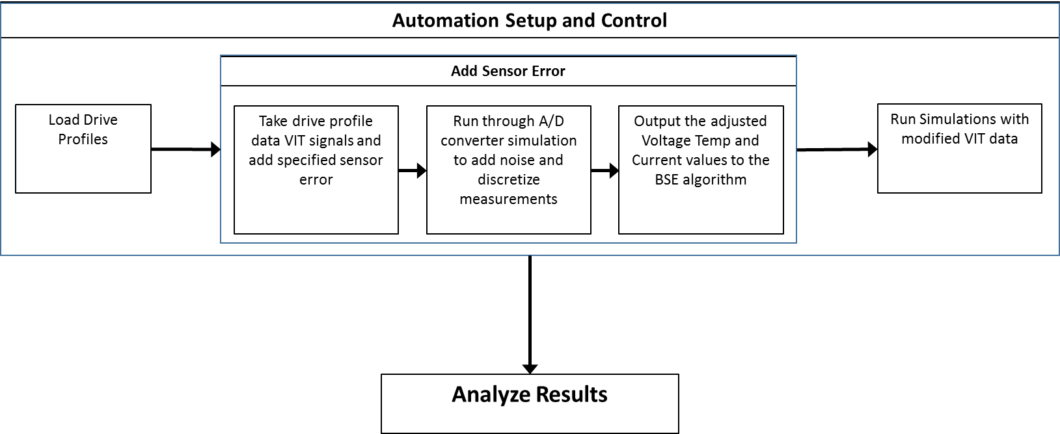
Optimization Details
I
D
D
O
V
Test setup
Form Revised 5/30/12
2012 Copyright General Motors - GM Information
8

Slide 18
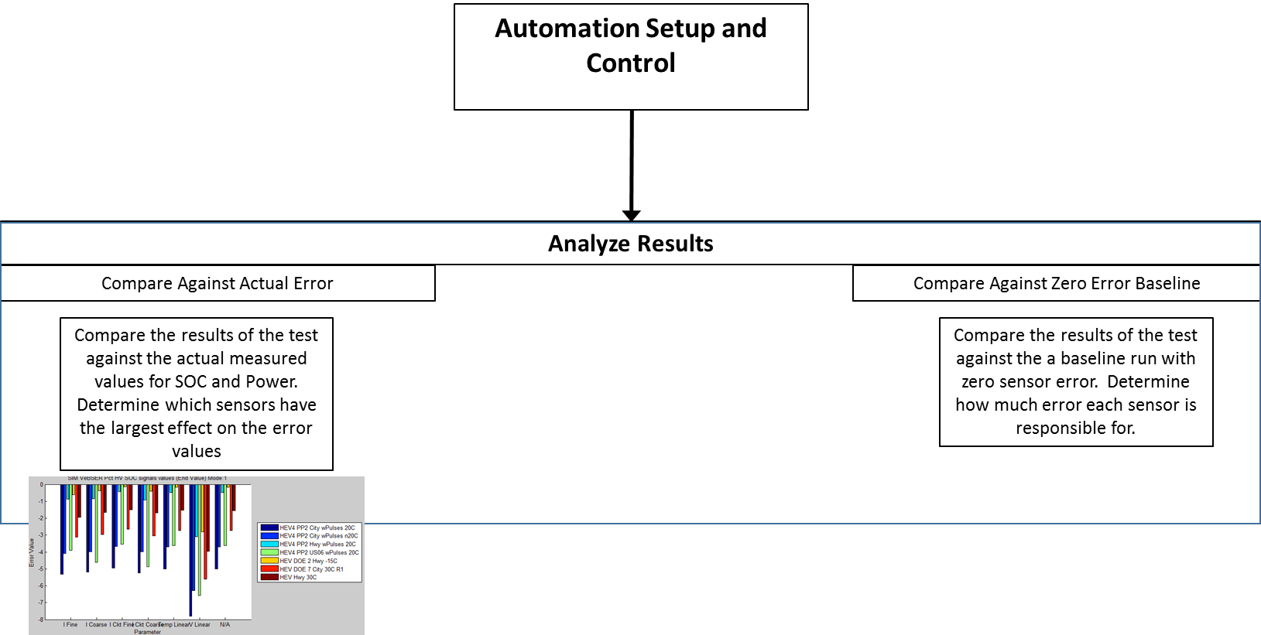
Optimization Details
I
D
D
O
V
Test setup
Form Revised 5/30/12
2012 Copyright General Motors - GM Information
9

Slide 19
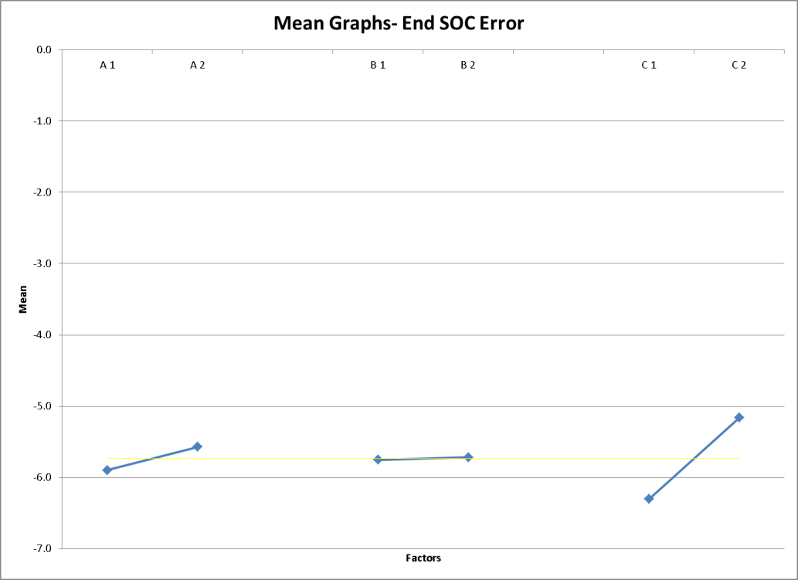
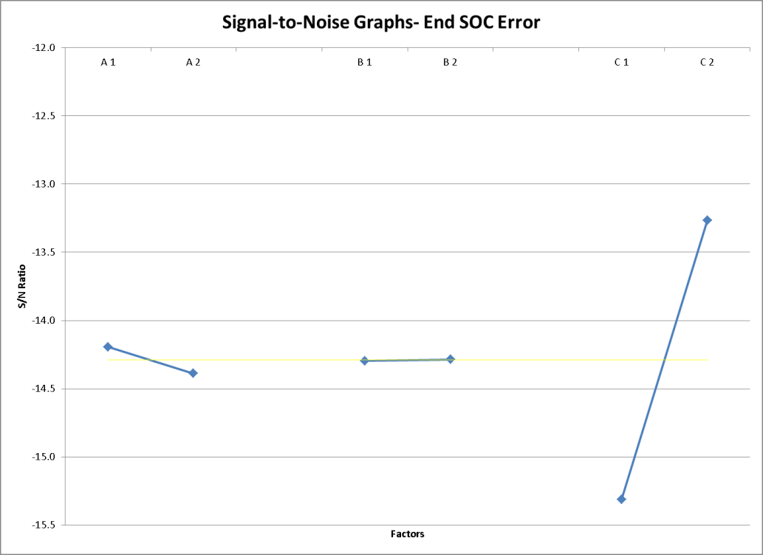
Response Plots
I
D
D
O
V
Nominal the Best
a1=small range | b1=high 1st stage gain
a2= large range | b2= low 1st stage gain
Notes:
Show a summary of what you did in the optimize phase. Present clearly what the results and conclusion are. If you used a DOE, the response plots are a quick why to show the results.

Slide 20
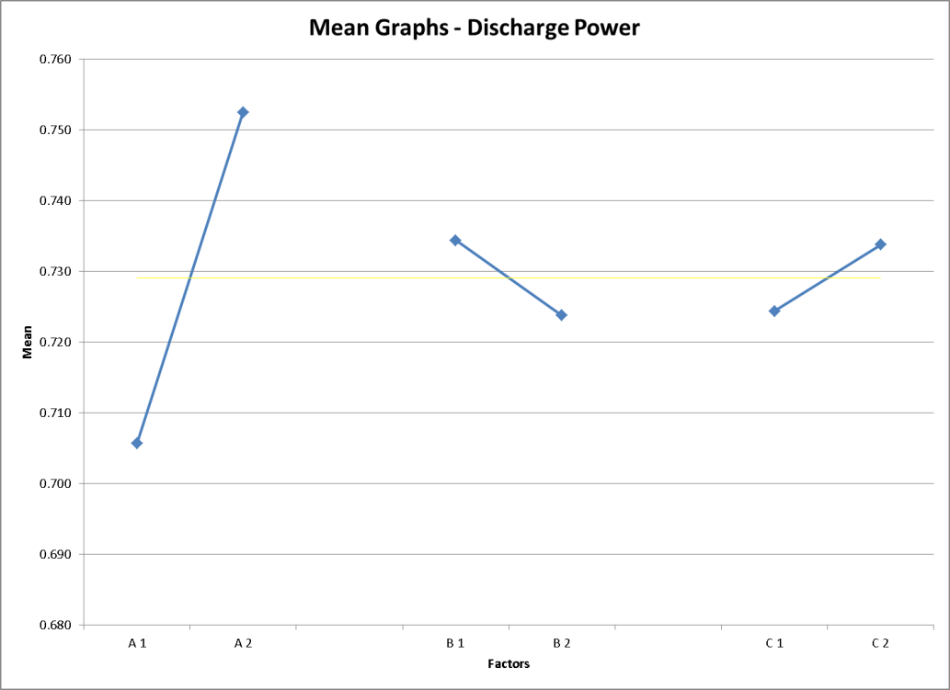

Response Plots
I
D
D
O
V
Nominal the Best
a1=small range | b1=high 1st stage gain
a2= large range | b2= low 1st stage gain
Notes:
Show a summary of what you did in the optimize phase. Present clearly what the results and conclusion are. If you used a DOE, the response plots are a quick why to show the results.

Slide 21
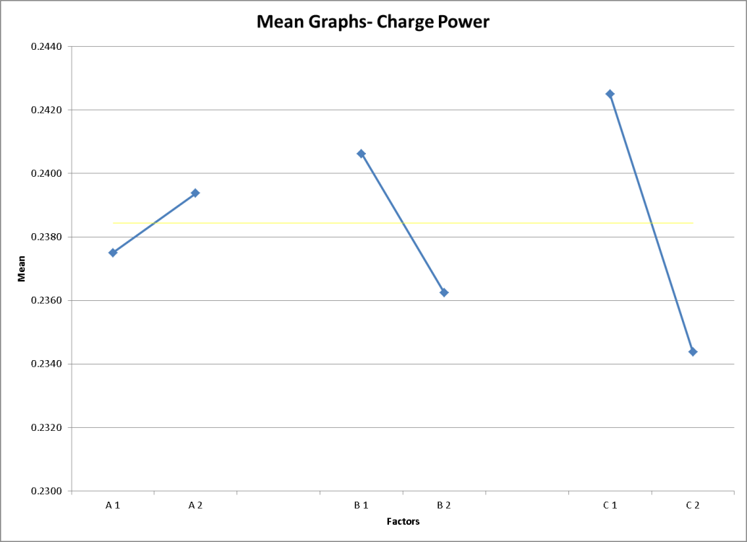
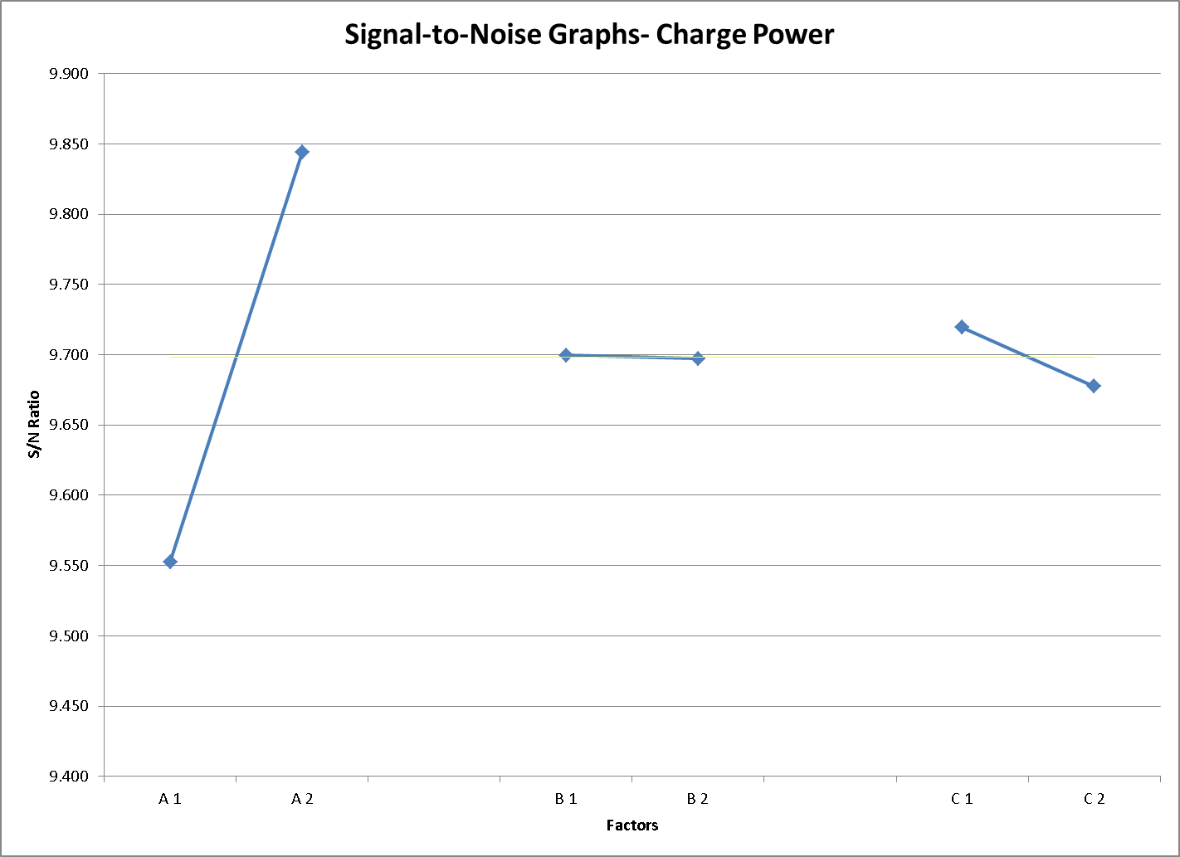
Response Plots
I
D
D
O
V
Nominal the Best
a1=small range | b1=high 1st stage gain
a2= large range | b2= low 1st stage gain
Notes:
Show a summary of what you did in the optimize phase. Present clearly what the results and conclusion are. If you used a DOE, the response plots are a quick why to show the results.

Slide 22
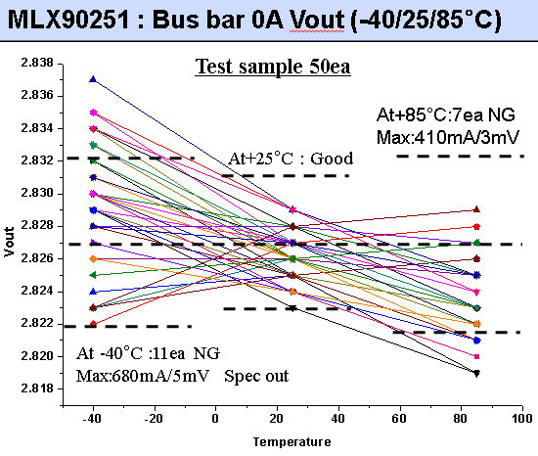
Verify Design Comparisons
I
D
D
O
V
Results of the study demonstrate a minimal gain in changes to the calibration to reduce the measured range. The results indicated a more significant impact of part-to-part variation than was achieved with the calibration. This was demonstrated in the contradicting results for different samples of the same sensor calibration showing a best and worst answer for some noise cases. Additionally, the signal-to-noise plots demonstrate that for charge and discharge power the control factors contradict each other.
The team has chosen not to change the current sensor calibration as it allows for a wider current range and will most likely see greater re-use in later programs.
Investigation of the part-to-part variation with the supplier has resulted in a proposed change to the current sensor chip (see analysis to right).
Notes:
However best demonstrated, compare the initial (baseline) and optimized designs. DELETE the example when finished.

Slide 23
Benefits
I
D
D
O
V
Identification of a method to analyze current sensor accuracy has been developed and can be re-used for future programs.
Quantitative analysis has demonstrated that the current sensor range is appropriate for this vehicle application.
Demonstrated that common parts for these applications are appropriate as the smaller current range program is not negatively affected.
Notes:
Quantify: Warranty reduction (IPTV, CPV), JD Power (PPH), etc. (improvement or avoidance)
Total cost savings and/or avoidance
Best practices for future designs

Slide 24
Recommended Future Work
I
D
D
O
V
Investigation around part-to-part variation should be conducted as shown in this work; a larger impact to BSE prediction was demonstrated than seen in the range calibrations.
Explore requirements to address part-to-part variation and its impact on charge, discharge, and SOC prediction error.
Recommend a change in IC for the current program to address variation seen in tested part.
Notes:
Classify the project deliverables according to these standard Closed-Loop Learning Process (CLLP) knowledge categories.

Slide 25
Implementation
I
D
D
O
V
No changes to the calibration are proposed as a result of this study.
Possible changes to the current sensor hall-effect IC will be investigated by Hannah Bence and Andrew Meintz and will be reviewed in the BAS3 and HEV4 PDTs.
Notes:
Include implementation plan with applicable details: design change, best practice, SOR change, standardize work, ect.
Include first program & future applications
What is the verification / validation plan?
Include timing & Responsible Engineer

Slide 26
Knowledge Capture & Share
I
D
D
O
V
This DFSS project will be reviewed in the Global Battery Systems team meeting.
Potential future update to requirements to capture effect of part-to-part variation will be suggested and reviewed within the systems engineering group. Updates to be included in RESS SSTS.
It is important to post the completed DFSS Project within your organization for knowledge share.
Notes:
The DFSS project posted in DFSS-GDM storage location is a record for certification purposes. The completed DFSS project and findings should be posted within your organization’s knowledge share.

Slide 27
Summary
This study demonstrated the effect of changing the calibration to reduce the current sensor range was not beneficial for the BAS3 and HEV4 programs.
Study appropriately demonstrated a method to analyze the range effects on the BSE and no range reduction benefit was identified. However, this study uncovered a need to better define requirements for part variation which was not completely understood before.
Analysis of the data was time consuming and would require additional resources.

Slide 28
Back-up Analysis

Slide 29
Part-to-Part Variation Confirmation
4-2. BAS3 Test data MLX90251 VS TLE4997: -40/+25/+85°C 24Hour
MLX90251 : Bus bar 0A Vout (-40/25/85°C) | TLE4997 : Bus bar 0A Vout (-40/25/85°C)
Test Sample 50ea (MLX90251) -. Calibrate 2,827±4mV at 0A -. -40/+25/+85°C 24Hour -. Apply 5V and measuring output. Output fluctuation at 0A (-40~+25°C) : -6mV Output fluctuation at 0A(+25~+85°C): +8mV At -40°C:11ea NG/ At +25°C:0ea NG/At +85°C:7ea NG | Test Sample 50ea (TLE4997) -. Calibrate 2,827±2mV at 0A -. -40/+25/+85°C 24Hour -. Apply 5V and measuring output. Output fluctuation at 0A (-40~+25°C) : -2mV Output fluctuation at 0A(+25~+85°C): +2mV All of Test sample meet Specification form -40°C to+85°C
Test sample 50ea
Test sample 50ea
At+85°C:7ea NG
Max:410mA/3mV
At +85°C : Good
At -40°C : Good
At+25°C : Good
At +25°C : Good
At -40°C :11ea NG
Max:680mA/5mV Spec out
6/8

Slide 30
SOC Evaluation
SOC Ahr – state of charge estimate based on current integration
Any error in current will be accumulated
SOC V – state of charge estimate based on modeling voltage characteristics of pack – open circuit voltage estimate
SOC Blended – blended estimate of Ahr and voltage SOC – actual reported SOC to outside world

Slide 31
City 25C Current Profile
RMS Current: 39.98

Slide 32
City 25C Deviation

Slide 33
City 25C SOC Ahr

Slide 34
City 25C SOC V

Slide 35
City 25C Blended SOC

Slide 36
City n10C Current Profile
RMS Current: 41.08

Slide 37
City n10C Deviation

Slide 38
City n10C SOC Ahr

Slide 39
City n10C SOC V

Slide 40
City n10C SOC Blended

Slide 41
US06 25C Current Profile
RMS Current: 62.99

Slide 42
US06 25C Deviation

Slide 43
US06 25C SOC Ahr

Slide 44
US06 25C SOC V

Slide 45
US06 25C SOC Blended

Slide 46
US06 40C Current Profile
RMS Current: 66.65

Slide 47
US06 40C Deviation

Slide 48
US06 40C SOC Ahr

Slide 49
US06 40C SOC V

Slide 50
US06 40C SOC Blended

Slide 51
City 25C SOC Deviation
SOC Ahr Deviation from shunt
SOC V Deviation from shunt
SOC Deviation from shunt

Slide 52
City 25C SOC Ideal Function

Slide 53
City 25C Percent Deviation in Charge Power Prediction

Slide 54
City 25C Chrg Power Ideal Function
Ideal based on measured power using Shunt Current Measurement and Cycler Voltage Measurement
*Capacity used was 5.119 Ahr

Slide 55
City 25C Percent Deviation in Discharge Power Prediction

Slide 56
City 25C Dschrg Power Ideal Function
Ideal based on measured power using Shunt Current Measurement and Cycler Voltage Measurement
*Capacity used was 5.119 Ahr

Slide 57
City n10C SOC Deviation
SOC Ahr Deviation from shunt
SOC V Deviation from shunt
SOC Deviation from shunt

Slide 58
City n10C SOC Ideal Function

Slide 59
City n10C Percent Deviation in Charge Power Prediction

Slide 60
City n10C Chrg Power Ideal Function
Ideal based on measured power using Shunt Current Measurement and Cycler Voltage Measurement
*Capacity used was 5.119 Ahr

Slide 61
City n10C Percent Deviation in Discharge Power Prediction

Slide 62
City n10C Dschrg Power Ideal Function
Ideal based on measured power using Shunt Current Measurement and Cycler Voltage Measurement
*Capacity used was 5.119 Ahr

Slide 63
US06 25C SOC Deviation
SOC Ahr Deviation from shunt
SOC V Deviation from shunt
SOC Deviation from shunt

Slide 64
US06 25C SOC Ideal Function

Slide 65
US06 25C Percent Deviation in Charge Power Prediction

Slide 66
US06 25C Chrg Power Ideal Function
Ideal based on measured power using Shunt Current Measurement and Cycler Voltage Measurement
*Capacity used was 5.119 Ahr

Slide 67
US06 25C Percent Deviation in Discharge Power Prediction

Slide 68
US06 25C Dschrg Power Ideal Function
Ideal based on measured power using Shunt Current Measurement and Cycler Voltage Measurement
*Capacity used was 5.119 Ahr

Slide 69
US06 40C SOC Deviation
SOC Ahr Deviation from shunt
SOC V Deviation from shunt
SOC Deviation from shunt

Slide 70
US06 40C SOC Ideal Function
Ideal based on measured power using Shunt Current Measurement and Cycler Voltage Measurement
*Capacity used was 5.119 Ahr

Slide 71
US06 40C Percent Deviation in Charge Power Prediction

Slide 72
US06 40C Chrg Power Ideal Function
Ideal based on measured power using Shunt Current Measurement and Cycler Voltage Measurement
*Capacity used was 5.119 Ahr

Slide 73
US06 40C Percent Deviation in Discharge Power Prediction

Slide 74
US06 40C Dschrg Power Ideal Function
Ideal based on measured power using Shunt Current Measurement and Cycler Voltage Measurement
*Capacity used was 5.119 Ahr

